Slide 1
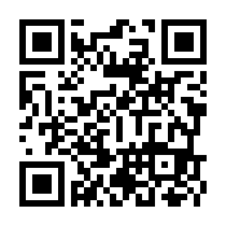
The Iwate Global Internship Program 2023
Iwate foreign residents!
Would you like to participate
in an internship?
To everyone who is a foreign student or who is a Jet Programme participant who is looking for further job opportunities! Would you like the chance to experience working at a Japanese company?
Participating businesses
・MIKUNI CORPORATION Morioka Operation (Takizawa City)
・Ark-net Ltd. (Morioka City)
※We will decide on a concrete schedule after consulting with the participants and hosting companies
Please check company information and internship details using the following link or QR code https://www.iwate-glocal.jp/
QR
Who can enter
〇 Foreign students In Iwate（We won’t ask what year you are or your major）
〇 Jet Programme participants from anywhere in Japan
Entry
criteria
〇 Foreign students or Jet Programme participants who have an interest in working in Japan
〇 Jet Programme participants who have gotten permission from their contracting organizations
〇 Those with Japanese proficient enough to participate in the internship
Cost
〇 Travelling expenses, accommodation, etc. are the responsibility of the individual
※A maximum of 5000 yen per person per night towards accommodation can be subsidized with this program.
This is an unpaid internship.
How to apply
〇 Please download and fill out the entry sheet on our website and send it to glocal-iwate@iwate-ia.or.jp
Application deadline: Friday February 16st 2024
Contact
Iwate Global Human Resources Development Council (Within Iwate International Association)
〒020-0045 Moriokaekinishidori, Morioka, Iwate 1-7-1 Aiina 5F
TEL：019-654-8900 FAX : 019-654-8922 Email ：glocal-iwate@iwate-ia.or.jp
Website
Iwate Global Human Resources Development Council ：https://www.iwate-glocal.jp/
Organized by Iwate Global Human Resources Development Council
This event is subsidized by the Council of Local Authorities for International Relations (CLAIR).

